Slide 1
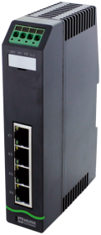
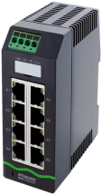
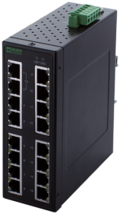
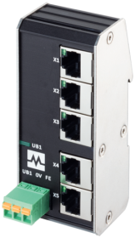
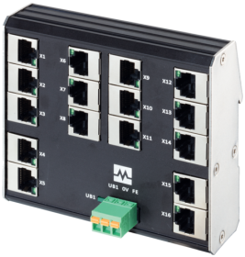
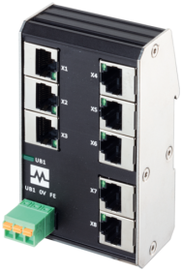
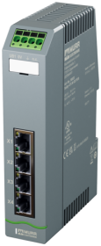
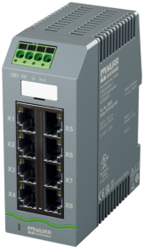
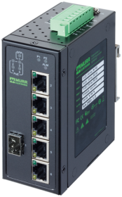
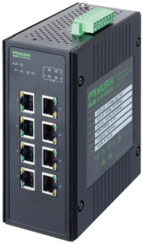
Find the right switch for your application
IP20 switches
in the control cabinet
Unmanaged
Managed
Profinet Managed
Power over ethernet (PoE)
Choose Data Transmission Rate
Data Transmission Rate
Data Transmission Rate
Data Transmission Rate
Fast Ethernet (100Mbit/sec)
Gigabit Ethernet (1000Mbit/sec)
Gigabit Ethernet (1000Mbit/sec)
Gigabit Ethernet (1000Mbit/sec)
Gigabit Ethernet (1000Mbit/sec)
Compact design
Low profile for shallow cabinet
Compact design
Low profile for shallow cabinet
Power supply 12/24VDC
Power supply 48/52VDC
4 ports – 58810
6 ports – 58811
8 ports – 58812
16 ports – 58174*
5 ports – 58900
8 ports – 58902
16 ports – 58904
4 ports – 58813
6 ports – 58814
8 ports – 58815
5 ports – 58906
8 ports – 58908
4 ports – 58820
6 ports – 58822
8 ports – 58824
4 ports – 58821
6 ports – 58823
8 ports – 58825
8 ports – 58192
4 PoE ports
4 Gigabit ports
5 ports – 58190
4 PoE ports
1 Gigabit port
8 ports – 58193
8 PoE ports
6 ports – 58191
4 PoE ports
1 Gigabit port
1 fiber optic port
10 ports – 58194
4 PoE ports
4 Gigabit ports
2 fiber optic port
* 2 Gigabit ports
Notes:
´´

Slide 2
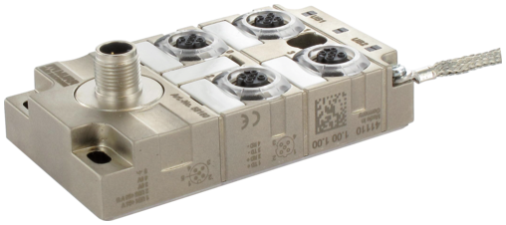
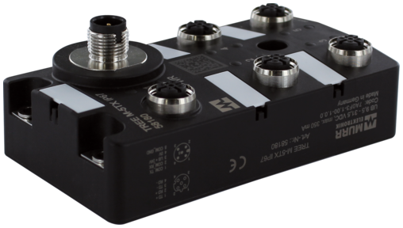
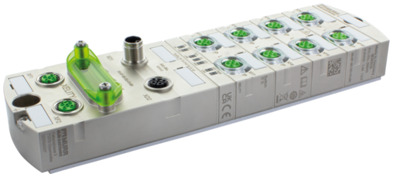
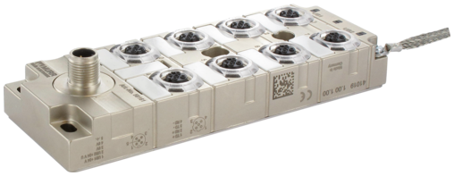
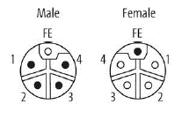
Find the right switch for your application
IP67 switches
in the field
Unmanaged
Managed
Profinet Managed
Data Transmission Rate
Choose Data Transmission Rate
Choose Data Transmission Rate
Fast Ethernet (100Mbit/sec)
Fast Ethernet (100Mbit/sec)
Gigabit Ethernet (1000Mbit/sec)
Fast Ethernet (100Mbit/sec)
Gigabit Ethernet (1000Mbit/sec)
Plastic housing
Metal housing
Metal housing
Plastic housing
Metal housing
Metal housing
4 ports – 58160
8 ports – 58161
5 ports – 58183
10 ports
58840 (4P)
58850 (5P)
10 ports
10 gigabit 58844 (4P)
10 gigabit 58854 (5P)
5 ports - 58184
10 ports
58841 (4P)
58851 (5P)
10 ports – 58190
10 Gigabit 58845 (4P)
10 Gigabit 58855 (5P)
10 ports
2 gigabit / 8 Mbit
58842 (4P)
58852 (5P)
10 ports
2 Gigabit / 8 Mbit
58843 (4P)
58853 (5P)
M12 L-coded powerconnector
4p: FE not connected
5P: FE connected
Notes:
´´

